Slide 1
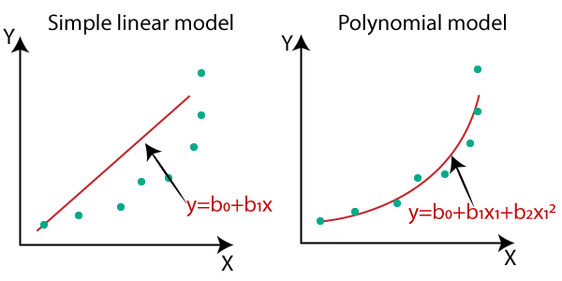
Polynomial Regression
Polynomial regression is a type of regression analysis in which the relationship between the independent variable (input) and the dependent variable (output) is modeled as an nth-degree polynomial. polynomial regression can capture the non-linear patterns in the data.

Slide 2
Polynomial Regression
Why Polynomial Regression?
we have non-linear data, then linear regression will not be able to draw a best-fit line. Simple regression analysis fails in such conditions.
we introduce polynomial regression to overcome this problem, which helps identify the curvilinear relationship between independent and dependent variables.

Slide 3
Polynomial Regression
Polynomial regression is a form of Linear regression where only due to the Non-linear relationship between dependent and independent variables, we add some polynomial terms to linear regression to convert it into Polynomial regression.
The general form of a polynomial regression equation is:
Y=β0​+β1​X+β2​X2+β3​X3+…+βn​Xn+ε
Here,
Y is the dependent variable,
X is the independent variable,
β0​,β1​,β2​,…,βn​ are the coefficients of the polynomial terms,
n is the degree of the polynomial, and
ε represents the error term.

Slide 4
Polynomial Regression
Suppose we have a dataset where variable X represents the Independent data and Y is the dependent data. Before feeding data to a mode in the preprocessing stage, we convert the input variables into polynomial terms using some degree.
Consider an example my input value is 35, and the degree of a polynomial is 2, so I will find 35 power 0, 35 power 1, and 35 power 2 this helps to interpret the non-linear relationship in data.

Slide 5
Polynomial Regression
How to find the right degree of the equation?
In order to find the right degree for the model to prevent over-fitting or under-fitting, we can use:
Forward Selection: This method increases the degree until it is significant enough to define the best possible model.
Backward Selection: This method decreases the degree until it is significant enough to define the best possible model.

Slide 6
Polynomial Regression
Bias-Variance Tradeoff:
Consider the bias-variance tradeoff. Lower-degree polynomials may result in underfitting (high bias), while higher-degree polynomials may lead to overfitting (high variance).
Choose a degree that achieves a good balance between bias and variance.

Slide 7
Lasso Regression
Lasso regression, short for Least Absolute Shrinkage and Selection Operator.
Lasso regression is a type of regression that uses shrinkage. Shrinkage is where data values are shrunk towards a central point.
If a regression model uses the L1 Regularization technique, then it is called Lasso Regression.

Slide 8

Lasso Regression
n: Number of observations
p: Number of features (independent variables)
yi​: Observed values of the dependent variable
y^​i​: Predicted values of the dependent variable
βj​: Coefficients of the independent variables
λ: Regularization parameter (also known as the shrinkage parameter or penalty parameter)

Slide 9
Ridge regression
Ridge regression—also known as L2 regularization.
Similar to lasso regression, ridge regression adds a penalty the square coefficient of independent variable.
Ridge tends to shrink coefficients smoothly, while Lasso can make some coefficients exactly zero, effectively excluding some features from the model.
When the number of predictor variables in a given set is more than the number of observations or when the dataset exhibits multicollinearity.

Slide 10
Ridge regression
ridge regression = MSE(θ) + λ * Σ(θ²)
MSE(θ) is the mean squared error, which measures the average squared difference between the predicted and actual values.
λ (lambda) is the regularization parameter, a non-negative hyperparameter that controls the amount of regularization applied. A higher λ value increases the regularization strength.
Σ(θ²) represents the sum of squared coefficients (θ) in the model.

